Slide 1
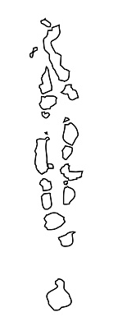

The GLOBE program in Maldives
By: Aishath Shaikha, EPA

Slide 2
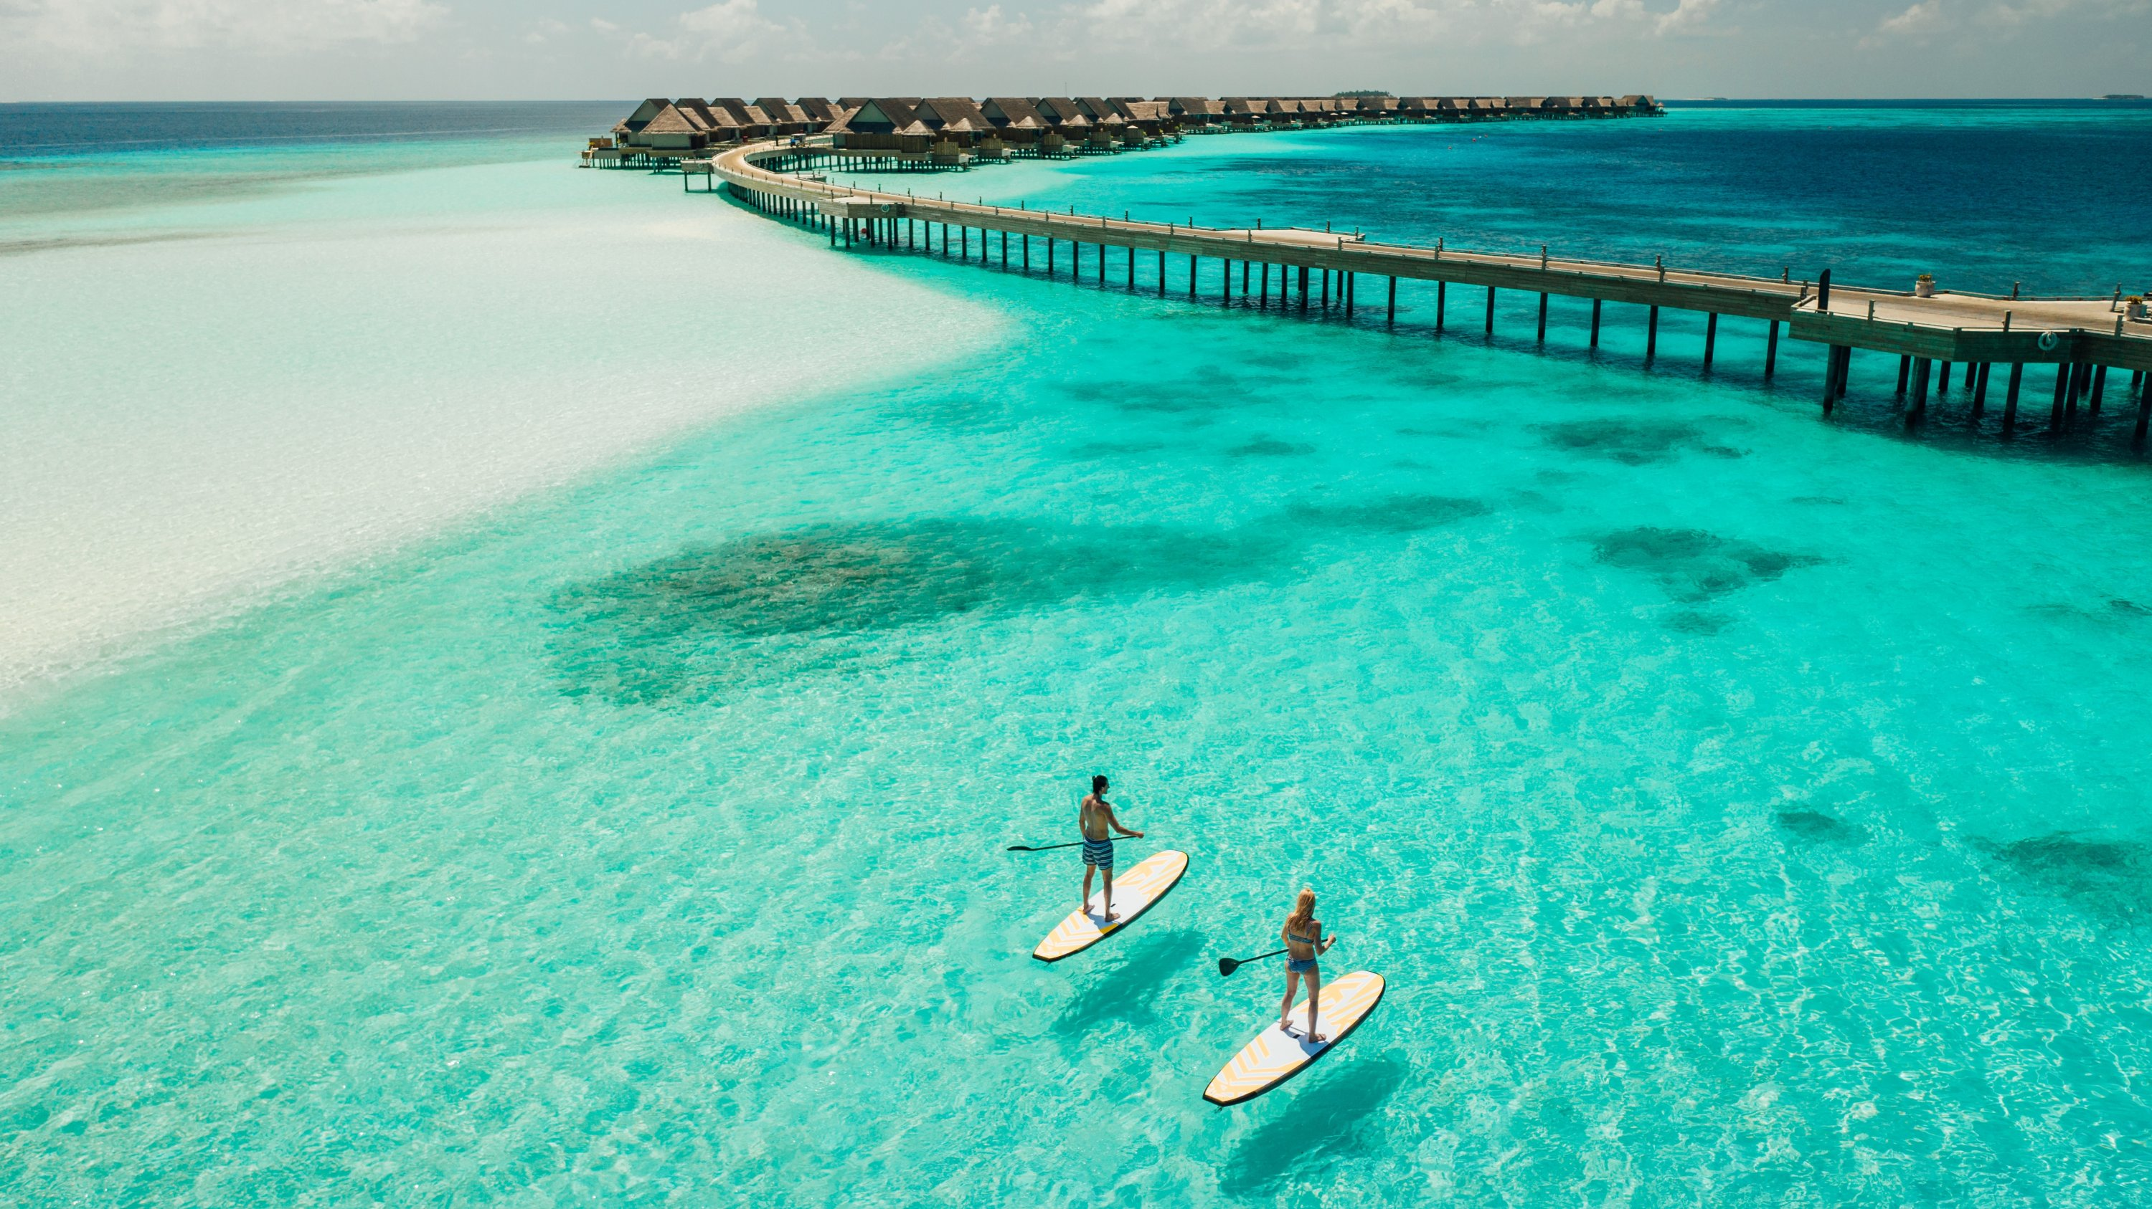
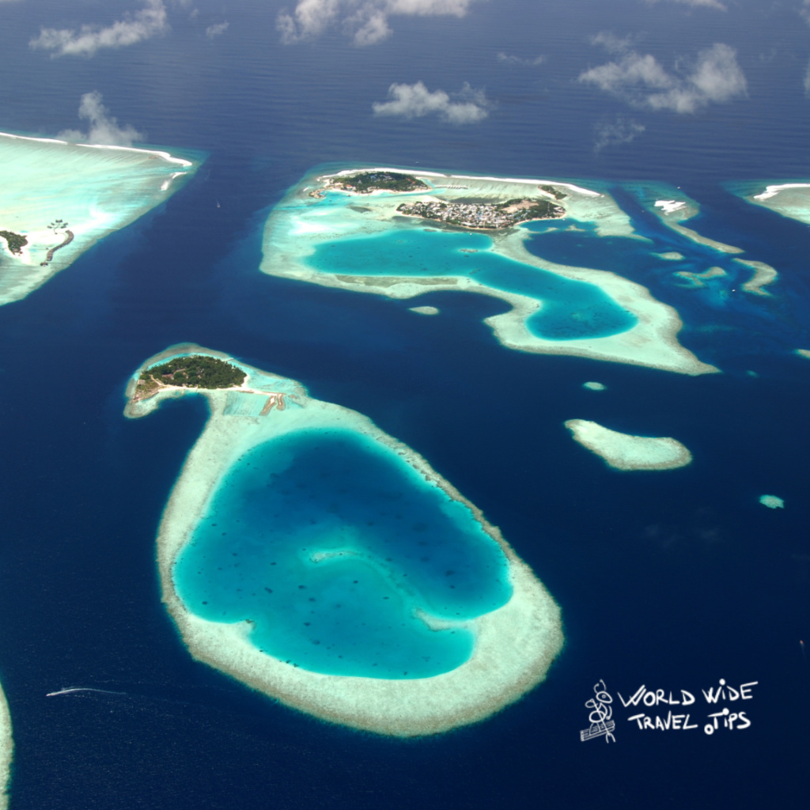
Introduction
Republic of Maldives, is an archipelagic country in the Indian subcontinent of Asia, situated in the Indian Ocean.
It’s territory is roughly 90,000 sq. km. including the sea. Land area of all the islands comprises 298 sq. km.
It is one of the smallest Asian Country with around 557,751 inhabitants.
Consists of 1,192 coral islands grouped in a double chain of 26 atolls, that stretch along a length of 871 kilometers (541 miles) north to south, 130 kilometers (81 miles) east to west.

Slide 3
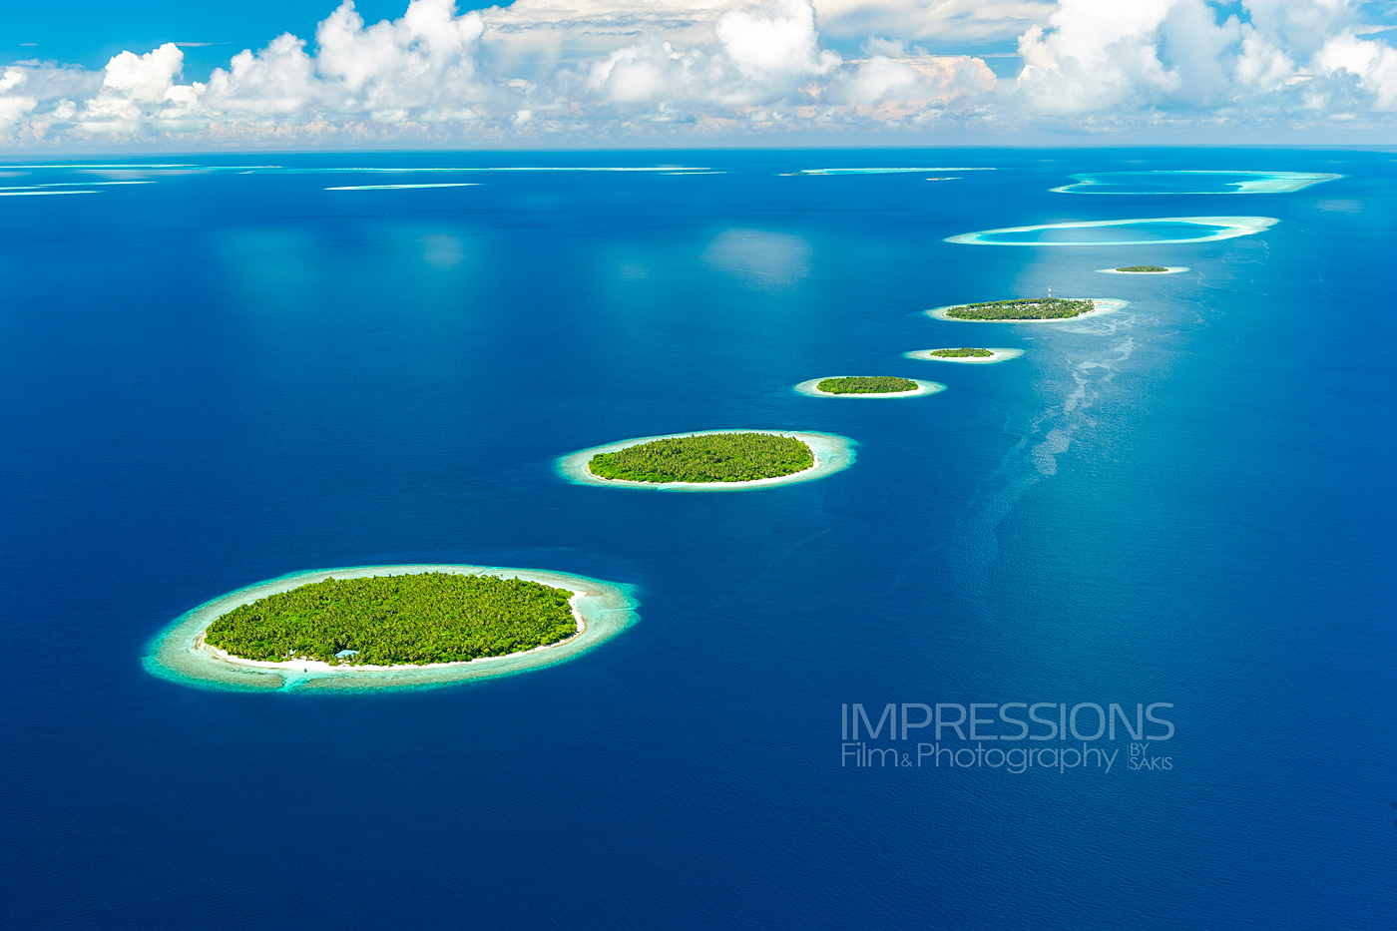
Introduction
Lowest country in the world, with maximum and average natural ground levels of only 2.4 m. It is considered as the Country to be most affected by Global Warming and Climate Change.
The Climate is Tropical Monsoon type with average yearly rainfall of 1900mm. Average temp is 28 degree Celsius and average relative humidity 75 %.

Slide 4
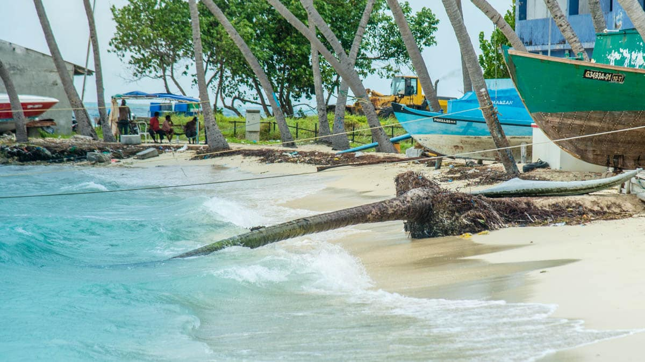
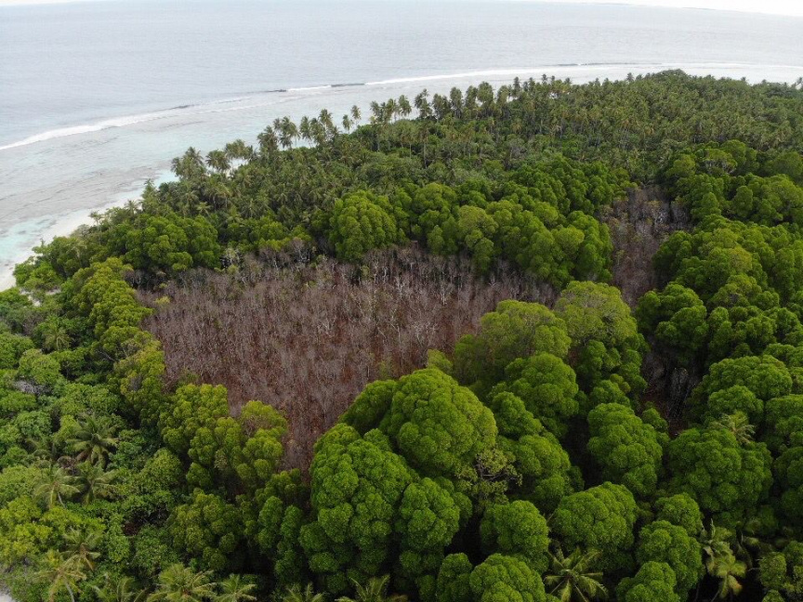
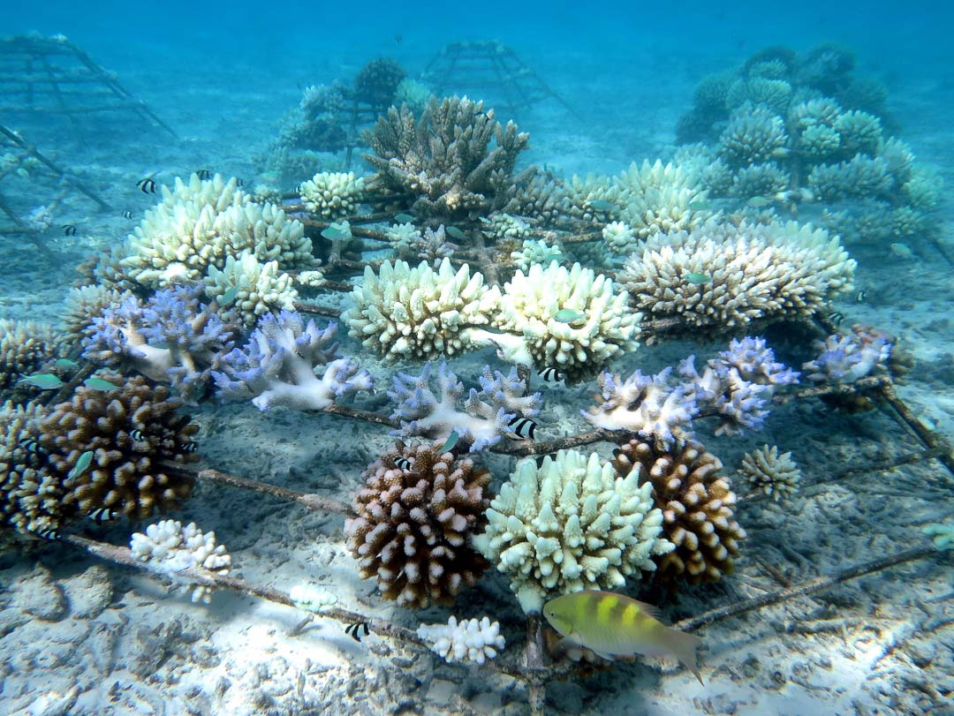

Slide 5

The GLOBE program in Maldives
Joined in the year 2003
20 schools identified as GLOBE schools
Preparations are underway to train the GLOBE teachers in Schools

Slide 6
The GLOBE program in Maldives
Targeted research area
Flora and Fauna Investigations
Soil investigation
Water quality Investigation
Atmosphere and Climate patterns

Slide 7
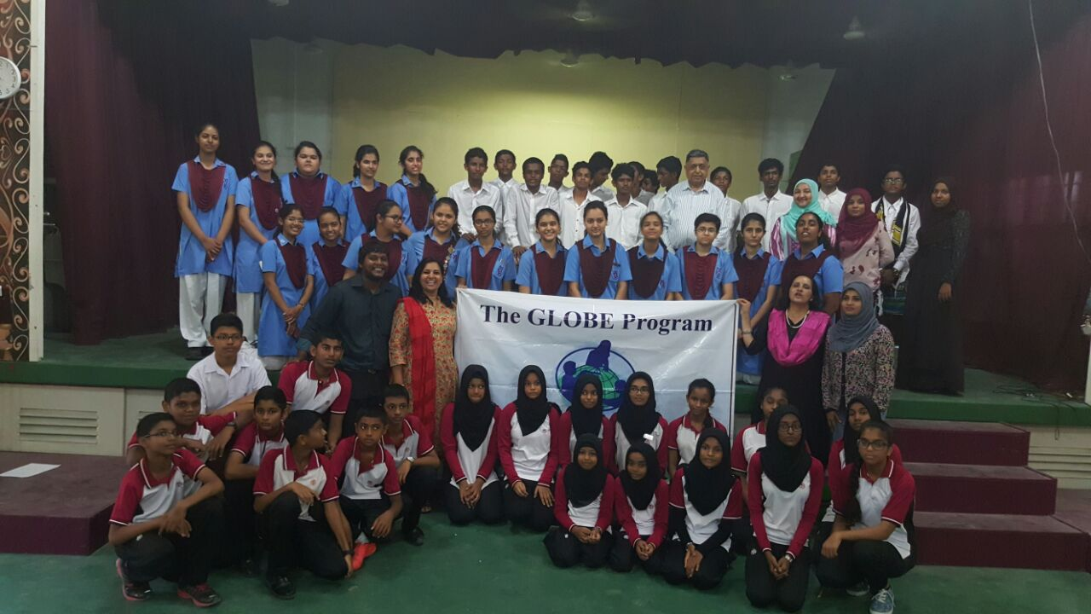
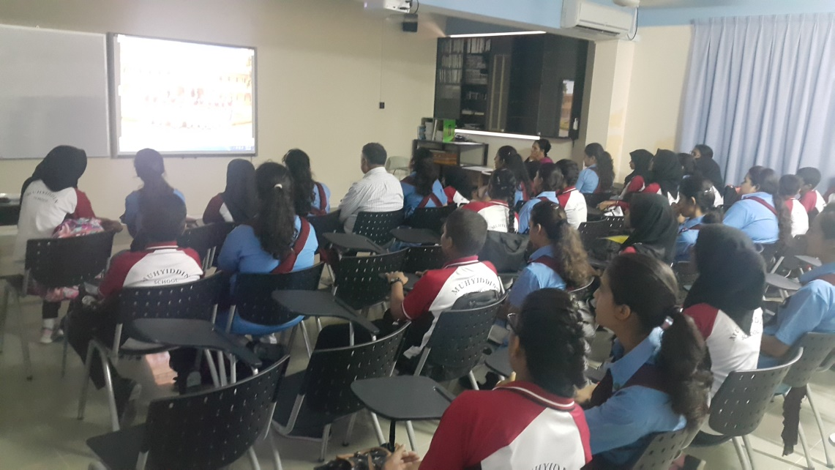
The GLOBE program in Maldives
A Team from Maharani Gayatri Devi Girl’s School visited Maldives from April 09th – 12th, 2016.
The team included of 20 participants, including students, Teachers and GLOBE Coordinator for Asia-Pacific Region
The Team visited 3 Schools in Maldives, which included Rehendhi School and Ghaazee School from Hulhumale’ and Muhiyiddeen School from Vilimale’.

Slide 8
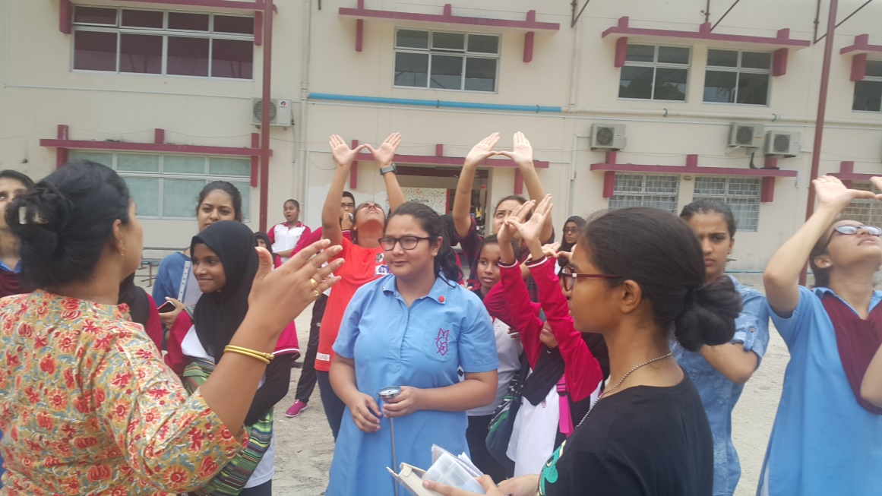
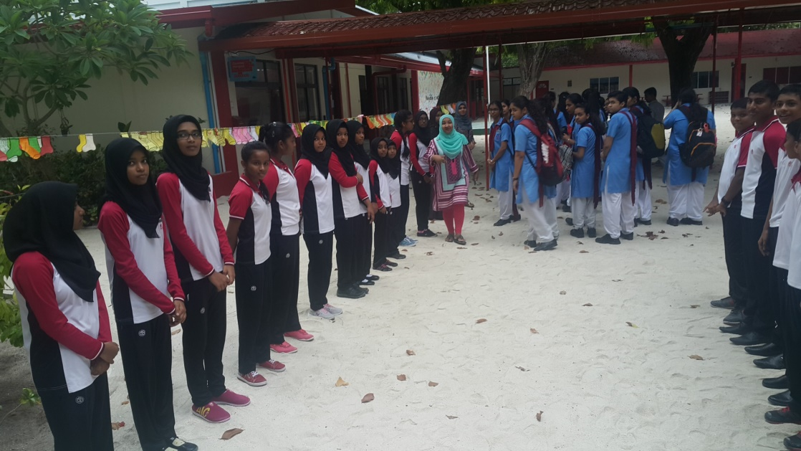

Slide 9
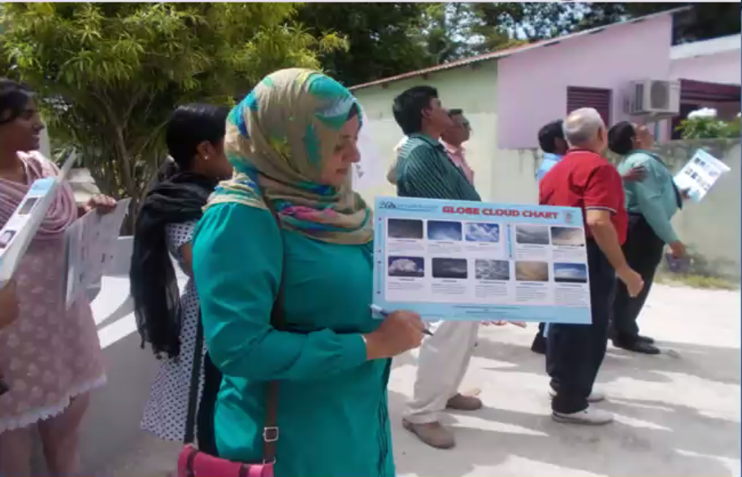
The GLOBE program in Maldives
The team visited Addu, Atoll (Southern most atoll in the Maldives
Teachers were trained
Exchanged equipment with the schools

Slide 10
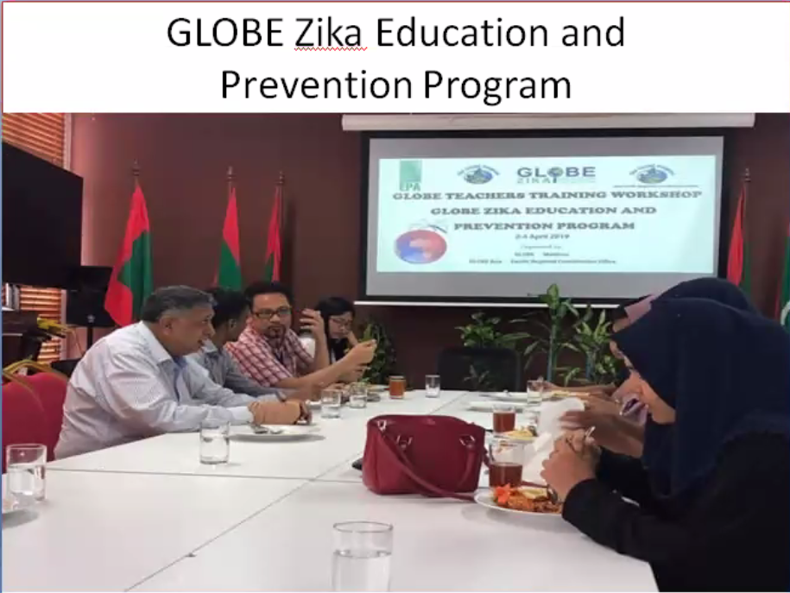

Slide 11
Programmes arranged for this year
Sea expedition
Add more schools to the globe programs
Train teachers in the schools

